Slide 1
Are You Smarter Than a Geologist?

Slide 2
Are You Smarter Than a Geologist?
1,000,000
500,000
300,000
Rock Types
Hardness
175,000
100,000
Dog’s Tooth
That’s Not Maggots
50,000
25,000
Turkey- Fat
Magnets
10,000
Wallboards
Arkansas State Mineral
5,000
2,000
Arkansas State Gem
Arkansas State Rock
1,000

Slide 3
Rock Types
There are 3 rock types based on how rocks were formed? What are the types and which one makes up 99% of all the rocks in Arkansas?

Slide 4
Rock Type Answer
Sedimentary, Igneous, and Metamorphic
Sedimentary rocks make up 99% of the rocks in Arkansas.
Return

Slide 5
Hardness Question
On Moh’s Hardness Scale 1 represents softest and 10 represents the hardest. Gypsum is a 2, and Diamond is what?

Slide 6
Hardness Answer
10
Return

Slide 7
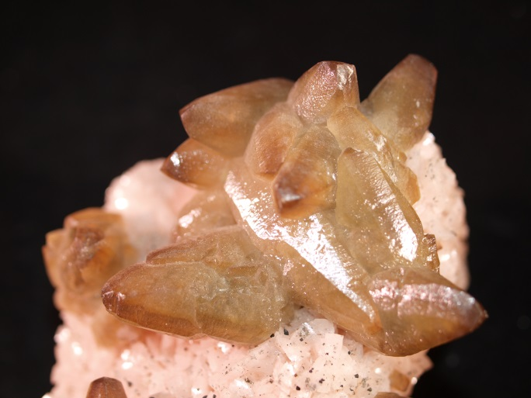
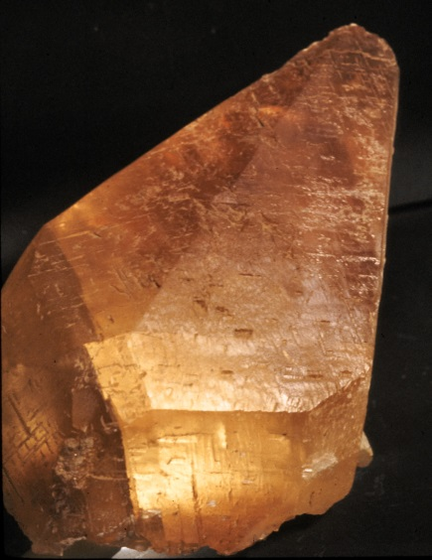
Dog’sTooth
This highly common Arkansas mineral occur in hexagonal shapes or some crystals form in the shape called dogtooth spar. It is made of Calcium Carbonate.

Slide 8
Dog’s Tooth Answer
Calcite
Return

Slide 9
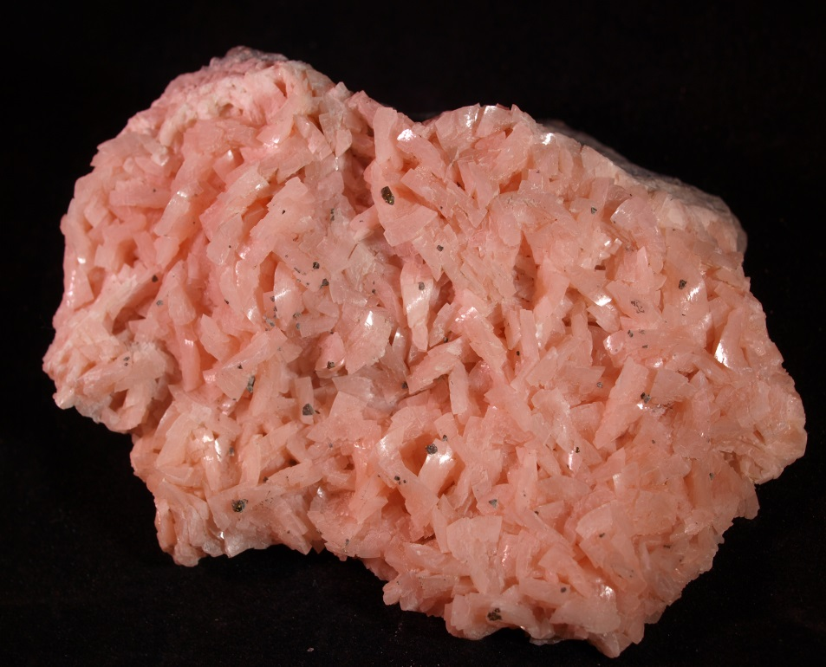
That’s Not Maggots Question
This pink mineral crystal is Calcium, Magnesium Carbonate and is used in making glass and antacids

Slide 10
That’s Not Maggots Answer
Dolomite
Return

Slide 11
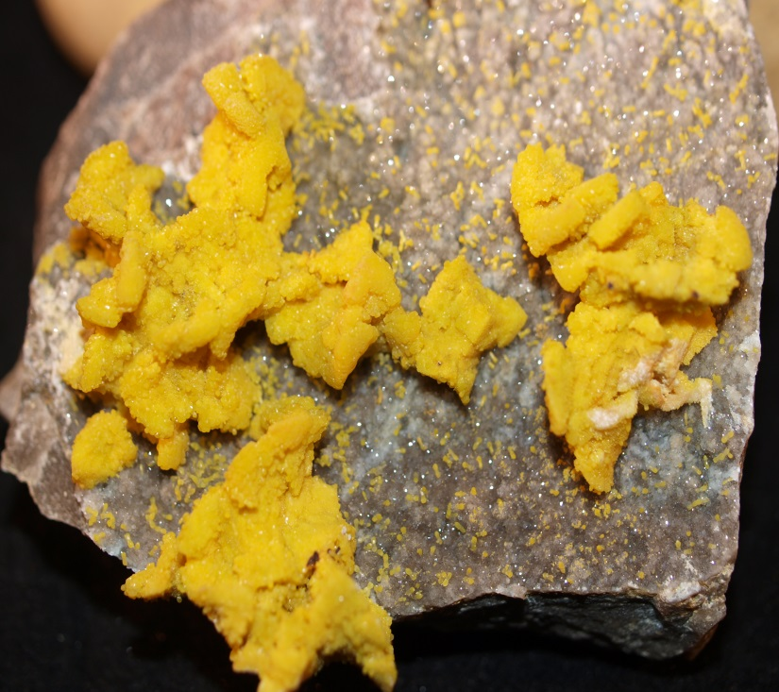
Turkey Fat Question
Turkey- Fat Ore is a common name given to this mineral that is often bright yellow in color. It contains Zinc and its crystals are hexagonal

Slide 12
Turkey Fat Answer
Smithsonite
Return

Slide 13
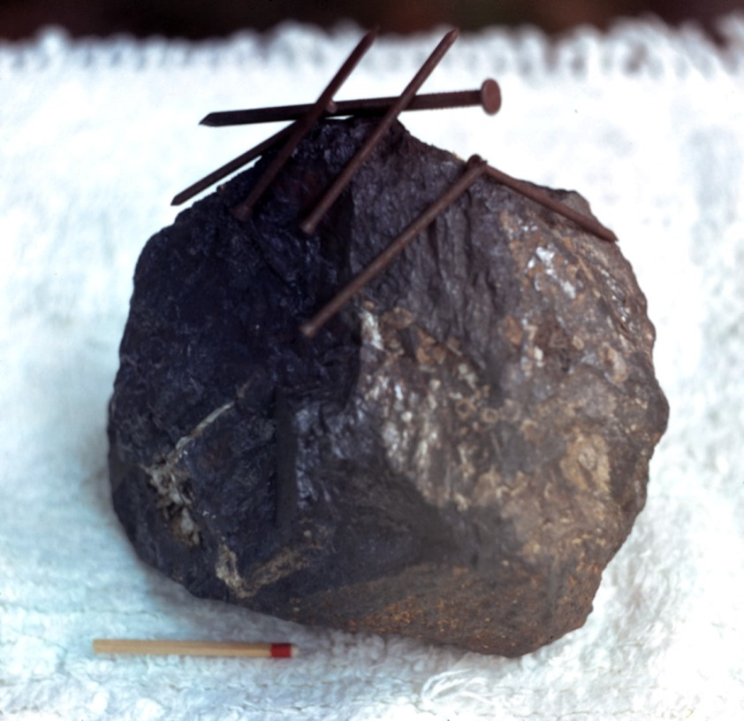
Magnets Question
This mineral is naturally magnetic and found in Magnet Cove, AR. What is it name?

Slide 14
Magnets Answer
Magnetite

Slide 15
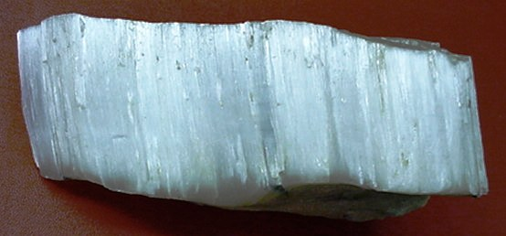
Wallboards Question
The mineral in this picture is used to make the wallboard in many homes. What is it called?

Slide 16
Wallboards Answer
Gypsum
Return

Slide 17
Arkansas State Mineral Question
These rock crystals have 6 sides and have a hardness of 7. They can be Smoky, Milky, or Amethyst.

Slide 18
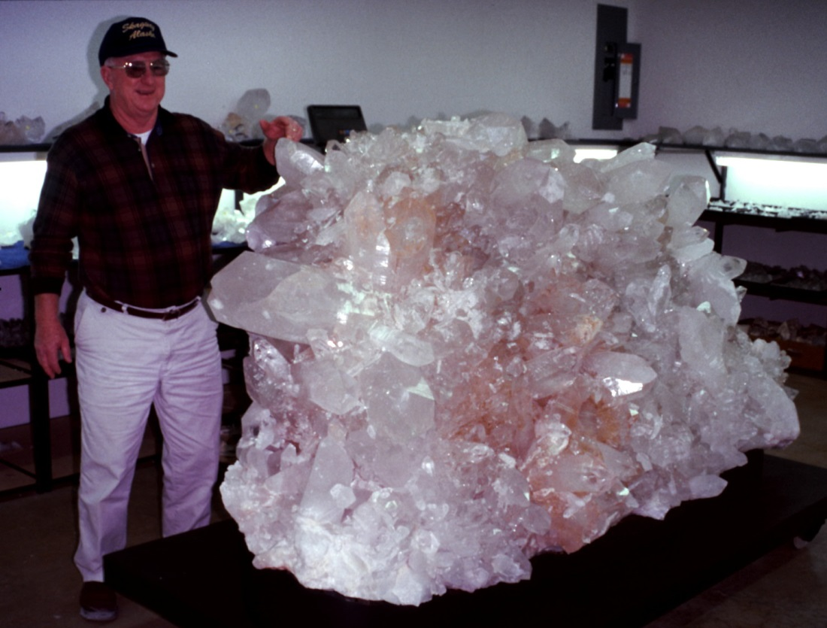
Arkansas State Mineral Answer
Quartz
Return

Slide 19
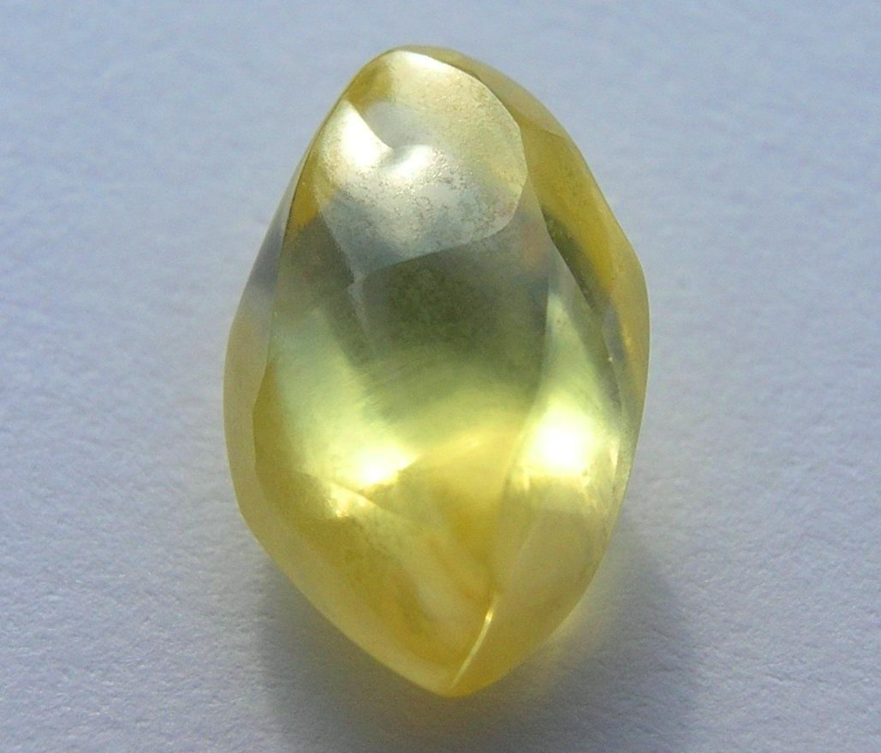
Arkansas State Gem Question
Where is the Arkansas State Gem found in the state?

Slide 20
Arkansas State Gem Answer
The Crater of Diamonds in Murfreesboro, AR
Return

Slide 21
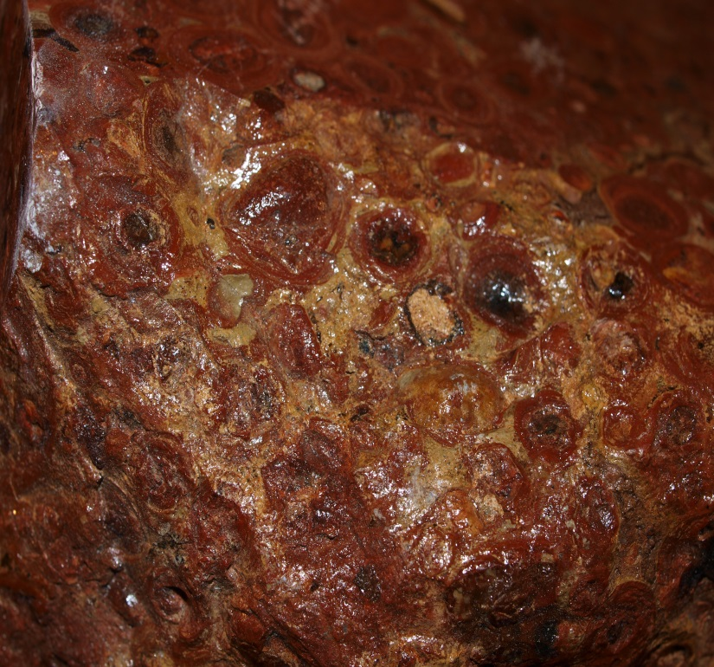
Arkansas State Rock Question
What is the type of rock shown in this picture?
It is used in Aluminum products.

Slide 22
Arkansas State Rock Answer
Bauxite
Return

Slide 23
Million Dollar Question
Are you ready for the million dollar question?
Here we go!

Slide 24
1,000,000 Question
Name one of the characteristics that define minerals.

Slide 25
1,000,000 Answer
Naturally Occurring
Crystalline solids meaning it is made up of minerals that are chemically combined in a regular repeating pattern in a solid form
Definite chemical composition
Return

Slide 26
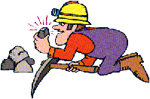
Thanks for Playing!

